Slide 1

Data Transform: Normalization, Standardization, Power Transform
Professor Bo Liu
James Watt School of Engineering

Slide 2
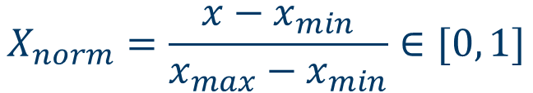
Data normalization
Data normalization (when non-Gaussian)
$$X_{norm}=\frac{x−x_{min}}{x_{max}−x_{min}}∈[0, 1]$$
See live script

Slide 3
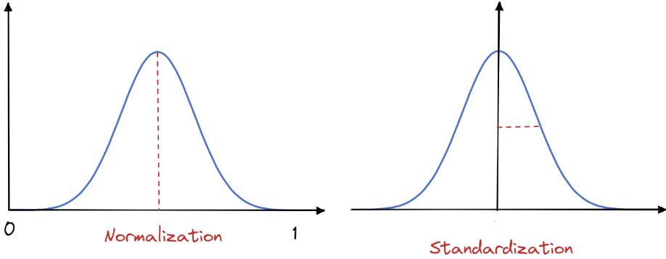

Data standardization
Data standardization (when Gaussian)
$$z=\frac{x−μ}{σ}$$
$$σ=1$$
μ
0
See live script

Slide 4

Power transform: remove skew
Power transforms are a family of data transform techniques
Use power functions.
The function is monotonic.
Power function:
$$f\left(x\right)=ax^{b}$$
Power transform

Slide 5
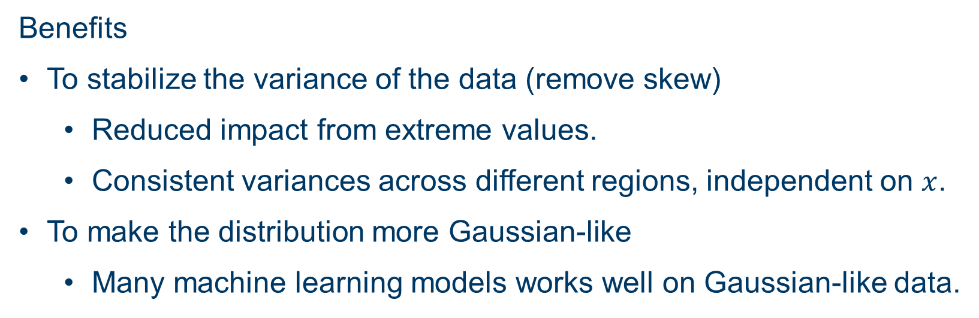
Power transform
Benefits
To stabilize the variance of the data (remove skew)
  Reduced impact from extreme values.
  Consistent variances across different regions, independent on $x$.
To make the distribution more Gaussian-like
  Many machine learning models works well on Gaussian-like data.

Slide 6
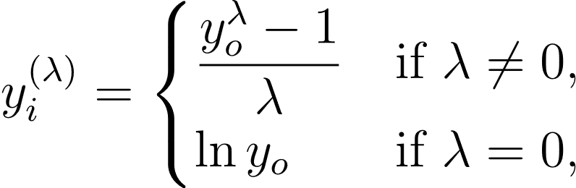
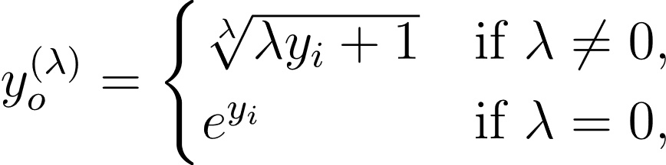
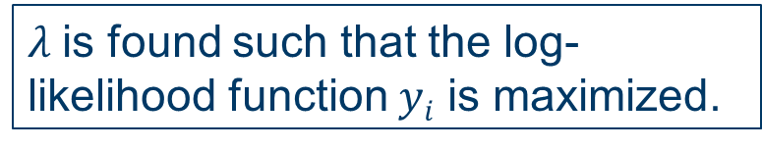
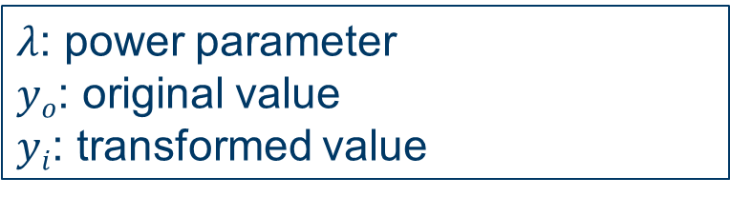
Power transform: Box-Cox transform
$λ$: power parameter
$yo$: original value
$yi$: transformed value
Box-Cox transform
$λ$is found such that the log-likelihood function $yi$ is maximized.
Box-Cox transform
Inverse Box-Cox
transform
Inverse Box-Cox transform
See live script

Slide 7
Power transform: Box-Cox transform
% Draw the histogram of the transformed distribution
% X: original samples
% Xb: transformed samples
% lambda: estimated power parameter
[Xb, lambda] = boxcox(X);
histogram(Xb);
Related functions:
boxcox
boxcoxinv_mooc
Box-Cox transform
Inverse Box-Cox
transform
% Invert the distribution back to its original form
histogram(boxcoxinv_mooc(Xb, lambda));
See live script

Slide 8




Thanks!
#UofGWorldChangers
@UofGlasgow

